Slide 1
Leveraging Azure to Build Notification Based Apps
Presented by David Ginn
6/29/2016

Slide 2
Agenda
Introduction
Lightning Talk
‘Introduction to Azure Service Fabric’
Q & A
Survey Prizes
Notes:
Briefly mention the prizes.
MS Band
Spher0 2.0
Cloud Monix
GC

Slide 3
Organizers
Notes:
Tom Straub
Eric Webb
Adam Howard
Kris Phillips

Slide 4
Mission
Notes:
The Cincinnati User Group exists to help developers, infrastructure engineers, and architects understand the Azure platform across it's full breadth of capabilities. Anything in Azure is fair game, including Infrastructure as a Service (IAAS), Platform as a Services (PAAS), Remote Apps, and all of the other wonderful capabilities that are in Microsoft's cloud platform.

Slide 5
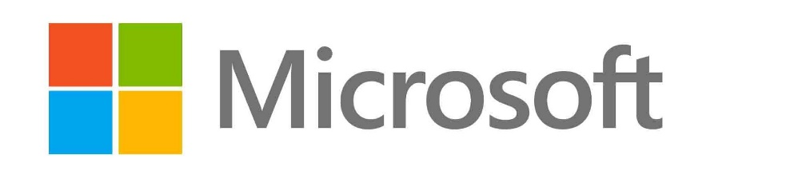



Sponsors
Notes:
Microsoft – Office Space
Cloud Monix – Free credits
Cardinal Solutions – Food and drinks

Slide 6
Lightning Talk
How are you using Azure?
Notes:
Engage the audience, get general azure experience from everyone, spark some small conversations
Ask about topics that interest the audience
Purpose: Get people talking/comfortable. Also gain insight into future topic suggestions.

Slide 7
Leveraging Azure to Build Notification Based Apps
Notes:
Mobile apps have always interested me
Specifically curious about push notifications (site examples – ESPN, Weather.com)
Platform Notification Services – specific code for iOS, Android, Windows, etc
Found Azure Notification Hub

Slide 8
DEMO TIME!
Building an end-to-end notification app in 15 minutes!
Notes:
Step-by-step on Github (show)
Go slightly out of order and provision Notification Hub first for demo

Slide 9
Sample App Technology Stack
Notes:
Sample App
Reporting App
User can request a report
Specifies report parameters
Submits report for processing
Brief introduction to all of the components in our technology stack. Not meant to be a comprehensive overview

Slide 10
Windows Universal App
Run on any Windows 10 Device (Phone, Tablet, PC)
Register tags with Notification Hub
User_davidmginn
Location_Cincinnati
Subject_Azure
Notes:
Purposes
Serve as UI
Register itself with Azure Notification Hub
Send report parameters to the next piece of our tech stack – Web API

Slide 11
ASP.NET Web API
Build Web APIs on top of the .NET Framework
Sends message to Azure Service Bus
Notes:
Allows for RESTful web services
Can be consumed by any platform
Sends message to azure service bus

Slide 12
Azure Service Bus
Messaging Service in the Cloud
Scalable
Notes:
Pub/Sub Model -> One application publishes message, another application subscribes and acts when a message is present
Scalable – don’t have to rely on your API to do the hard processing – many clients can subscribe to service bus
Particularly useful for potentially long running processes
Prevents from having to lock the UI
Rackspace Orbitera Scenario

Slide 13
Web Job
Receives message from Service Bus
Web Jobs SDK
Always Running, Scheduled, On-demand
Sends push notification upon completion
Notes:
Background task published to an Azure Web Site
Web Jobs SDK allows for listening to various actions

Slide 14
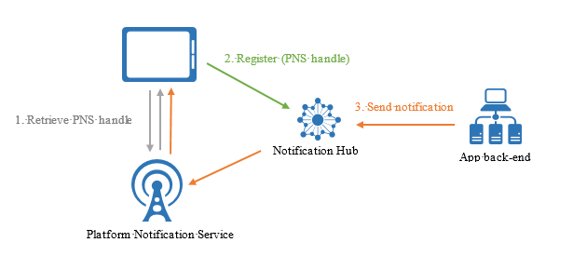
Azure Notification Hub
Abstraction
iOS
Android
Windows
More…

Slide 15
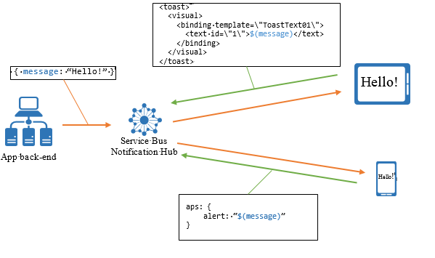
Cross Platform Notifications
Register template
Push key/value pairs

Slide 16
Q/A
Notes:
https://www.random.org/integers/?num=1&min=1&max=100&col=5&base=10&format=html&rnd=new

